Slide 1

Support The Management Of Trauma In The Emergency And Urgent Care
Setting
Component 8
Suspension trauma
Hanging trauma
Blast injuries
Ballistic injuries

Slide 2


Suspension, Hanging, Blast and Ballistics - Component 8
Subjects covered during this training session may evoke memories of incidents that you have witnessed or been involved in.
If you have any concerns then please discuss them with your Course Director/staff at the education centre.
Support is available to all staff, more information is available on The Pulse
LINC Emergency on Call – 0207 922 7539
Staff Counselling Referral Line – 0800 0214 155
MIND Blue Light Infoline – 0300 123 3393
TRiM Assessment- Information available via the Pulse
Wellbeing Hub – 0203 162 7554
Notes:
Information correct as of 22/11/22

Slide 3
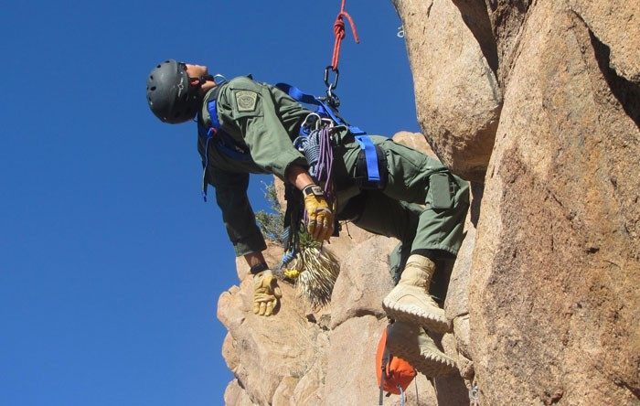
Suspension Trauma
Suspension, Hanging, Blast and Ballistics – Component 8
Notes:
Ref: AACE : Unit 20 Sections 9 & 10 refers to ‘Suspension injuries.’ The term ‘Suspension Trauma ‘ is preferred by Health and Safety Executive & LAS.
Ambulance Care Essentials 2nd Edition Chapter 16, pg 254
Suspension trauma not covered by JRCALC+ (May 2020)
LAS Clinical Update Suspension Trauma – Update. @ https://thepulseweb.lond-amb.nhs.uk/clinical/clinical-update/ Issue 13 (Oct 2008)
“The existence of suspension trauma or orthostatic shock syndrome has been debated over the past few years. A document issued by the Health and Safety Executive in 2002 brought this condition to the forefront of first aid provision for all patients who wear harnesses and work at a height. It was thought that these patients were at risk of premature unconsciousness due to impaired venous return and that there were treatment implications in laying the patient flat to manage them. However following an extensive literature review JRCALC have made the clinical decision that these patients need no specific treatment, other than for other injuries and / or illnesses
that might have also occurred before or during the fall. “
This has been supported further by a document released by the Health and Safety Executive (September 2008) which made 5 recommendations, in summary:
• No change should be made to the standard first aid guidance for the post recovery of these patients.
• No change should be made to the standard UK first aid guidance of ABC management.
• A casualty who is experiencing symptoms whilst suspended should be rescued as soon as possible.
• Elevation of the legs where possible may prolong tolerance of suspension.
• The signs and symptoms of harness suspension intolerance include: light headedness, nausea, sensation of flushing, tingling or numbness of the arms and legs; anxiety; visual disturbance or a feeling they are about to faint.

Slide 4

Suspension Trauma
Suspension, Hanging, Blast and Ballistics – Component 8
What is it?
“A casualty who is experiencing pre-syncopal symptoms or who is unconscious whilst suspended in a harness..”
They “should be rescued as soon
as is safely possible.”
Notes:
Ref: Definition: Health and Safety Executive (September 2008) @ http://www.hse.gov.uk/firstaid/whats-new/harness.htm
LAS Clinical Update Suspension Trauma – Update. @ https://thepulseweb.lond-amb.nhs.uk/clinical/clinical-update/ Issue 13 (Oct 2008)
“The existence of suspension trauma or orthostatic shock syndrome has been debated over the past few years. A document issued by the Health and Safety Executive in 2002 brought this condition to the forefront of first aid provision for all patients who wear harnesses and work at a height. It was thought that these patients were at risk of premature unconsciousness due to impaired venous return and that there were treatment implications in laying the patient flat to manage them. However following an extensive literature review JRCALC have made the clinical decision that these patients need no specific treatment, other than for other injuries and / or illnesses
that might have also occurred before or during the fall. “
This has been supported further by a document released by the Health and Safety Executive (September 2008) which made 5 recommendations, in summary:
• No change should be made to the standard first aid guidance for the post recovery of these patients.
• No change should be made to the standard UK first aid guidance of ABC management.
• A casualty who is experiencing symptoms whilst suspended should be rescued as soon as possible.
• Elevation of the legs where possible may prolong tolerance of suspension.
• The signs and symptoms of harness suspension intolerance include: light headedness, nausea, sensation of flushing, tingling or numbness of the arms and legs; anxiety; visual disturbance or a feeling they are about to faint.

Slide 5
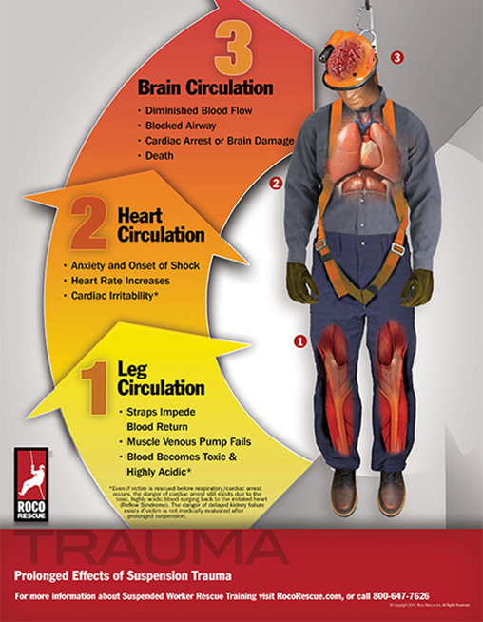
Suspension Trauma
Suspension, Hanging, Blast and Ballistics – Component 8
The pathophysiology:
“Lower extremity venous circulation is exclusively
dependent on muscle contraction..
When suspended and immobile,
a "cascading" event can occur
almost immediately.
Notes:
Ref: Ellen L. Smith MD in JEMS @ http://www.jems.com/articles/print/volume-40/issue-6/features/redefining-the-diagnosis-and-treatment-of-suspension-trauma.html (accessed 12th Feb 2016).
Pathophysiology
“Lower extremity venous circulation is exclusively dependent on muscle contraction. When suspended and immobile, a "cascading" event can occur almost immediately. Some of the more common causes of being rendered immobile include: injury, confusion, physical/emotional exhaustion, pain, hypoglycemia and muscle failure.4 What can't be ignored is prolonged working, observation, or even rescue efforts of an injured patient without the rescuer consciously moving the lower extremities.
Failure of the venous return circulation to be executed through muscle contraction can result in a relatively rapid accumulation of 20% of blood volume in the lower extremities. If not checked, this can increase to 60% with only a remote chance of survival. As blood volume pools it becomes acidic due to hypoxia and resultant anaerobic metabolism in muscle cells evolving into rhabdomyolysis. This death of muscle tissue causes a release of enzymes in the blood, an increase in myglobin release and hyperkalemia, all of which can lead to renal failure.”

Slide 6
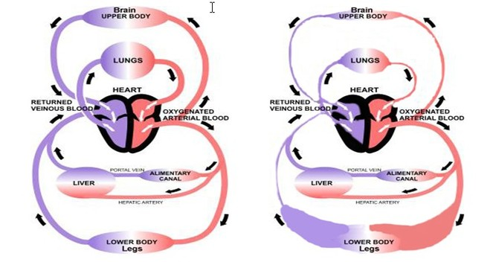
Suspension Trauma
Suspension, Hanging, Blast and Ballistics – Component 8
‘Suspension cascade’
Victim can’t escape vertical position
with legs dangling
3-6 mins - venous pooling begins
unless legs are moving
6-12 mins - obstruction of venous returns worsens
as harness compresses femoral veins. Harness and abdominal pressure compresses inferior vena cava
Loss of consciuosness follows
Notes:
Ref: Diagram from: SUSPENSION TRAUMA: A LETHAL CASCADE OF EVENTS . DR. NORMAN WOOD (2012) @ http://www.fallsafety.com/wp-content/uploads/2013/03/NormanWoodsSuspensionTraumaALethalCascadeOfEvents.pdf
Explanation from: Ellen L. Smith MD in JEMS @ http://www.jems.com/articles/print/volume-40/issue-6/features/redefining-the-diagnosis-and-treatment-of-suspension-trauma.html (accessed 12th Feb 2016).
Pathophysiology
“Lower extremity venous circulation is exclusively dependent on muscle contraction. When suspended and immobile, a "cascading" event can occur almost immediately. Some of the more common causes of being rendered immobile include: injury, confusion, physical/emotional exhaustion, pain, hypoglycemia and muscle failure.4 What can't be ignored is prolonged working, observation, or even rescue efforts of an injured patient without the rescuer consciously moving the lower extremities.
Failure of the venous return circulation to be executed through muscle contraction can result in a relatively rapid accumulation of 20% of blood volume in the lower extremities. If not checked, this can increase to 60% with only a remote chance of survival. As blood volume pools it becomes acidic due to hypoxia and resultant anaerobic metabolism in muscle cells evolving into rhabdomyolysis. This death of muscle tissue causes a release of enzymes in the blood, an increase in myglobin release and hyperkalemia, all of which can lead to renal failure.”

Slide 7

Suspension Trauma: Management
Suspension, Hanging, Blast and Ballistics – Component 8
“..standard UK first aid guidance of ABC management”
“If the rescuer is unable to immediately release a conscious casualty from a suspended position, elevation of the legs by the casualty or rescuer where safely possible may prolong tolerance of suspension”
They “should be rescued as soon
as is safely possible”
Notes:
Management as per guidance of Health and Safety Executive (September 2008) @ http://www.hse.gov.uk/firstaid/whats-new/harness.htm

Slide 8

Suspension Trauma
Suspension, Hanging, Blast and Ballistics – Component 8
Any Questions?

Slide 9
Suspension, Hanging, Blast and Ballistics – Component 8
Hanging

Slide 10
Hanging
Suspension, Hanging, Blast and Ballistics – Component 8
Hanging is the most common method of suicide accounting for 61% of all suicides in those aged 10 years and over. Hanging may be accidental or deliberate, or fully or partially supported.
Hanging may also be defined as a short drop or a log drop
A short drop is where death is caused by asphyxia due to compression of the airway and blood vessels in the neck.
A long drop is where death is caused as a result of a fracture-dislocation of the upper cervical vertebrae.
There is no definition of the height required for either drop and the approximately height should be noted and handed over to receiving staff.
Notes:
Fully supported = where the entire body weight is supported by the ligature
Partially support= where only part of the body weight is support by the ligature.
Reference JRCALC Plus – Trauma Emergencies in Adults- Overview – Hanging

Slide 11
Hanging
Suspension, Hanging, Blast and Ballistics – Component 8
Management :
Undertake a dynamic risk assessment
Identify if there are signs of life or the need for resuscitation
Remove (and if necessary cut) ligatures
Call for help at an early stage
Move the patient to an appropriate position for assessment & management (considering C spine care)
The airway should take priorities over C spine management if required
Airway management may be difficult, due to the potential for airway injury and swelling.
Notes:
Reference JRCALC Plus – Trauma Emergencies in Adults- Overview – Hanging

Slide 12
Hanging
Suspension, Hanging, Blast and Ballistics – Component 8
Management :
If No CPR is commenced, where possible staff should not disturb the scene to assist the police with their investigations.
Post ROSC Care
Be aware that patients are likely to be hypoxic and agitated and may need specialist on scene care.
The possibility of spine or spinal cord injury should also be considered.
Notes:
Specialist care could include HEAMS, paramedics, APP trauma or a on screen doctor.
Reference JRCALC Plus – Trauma Emergencies in Adults- Overview – Hanging

Slide 13
Hanging
Suspension, Hanging, Blast and Ballistics – Component 8
Remember- Welfare
All staff may be affected by this type of incident, either in the short or longer term. Staff should have access to wellbeing services and a post-incident debrief.
Bystander, witnesses and families may also need signposting to support services as well.
Notes:
Remind staff of current LAS well being services
Reference JRCALC Plus – Trauma Emergencies in Adults- Overview – Hanging

Slide 14
Hanging
Suspension, Hanging, Blast and Ballistics – Component 8
Any Questions ?

Slide 15
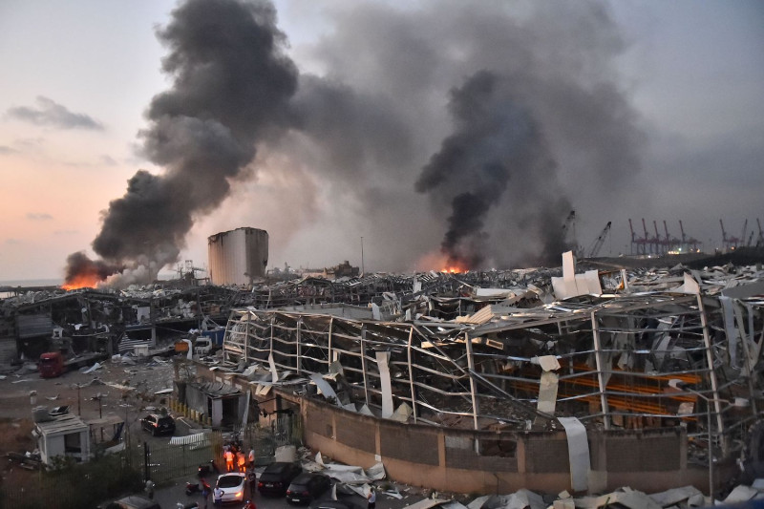
Blast Injuries
Suspension, Hanging, Blast and Ballistics – Component 8
Notes:
Picture of Beirut after the explosion of amil nitrate stored in warehouse 2020

Slide 16
Blast Injuries
Suspension, Hanging, Blast and Ballistics – Component 8
Warfare/terrorism
Industrial/residential
    Gas leaks
    Factories, commercial sites
    Fuel refineries
    Transport
Notes:
At risk from the following.

Slide 17
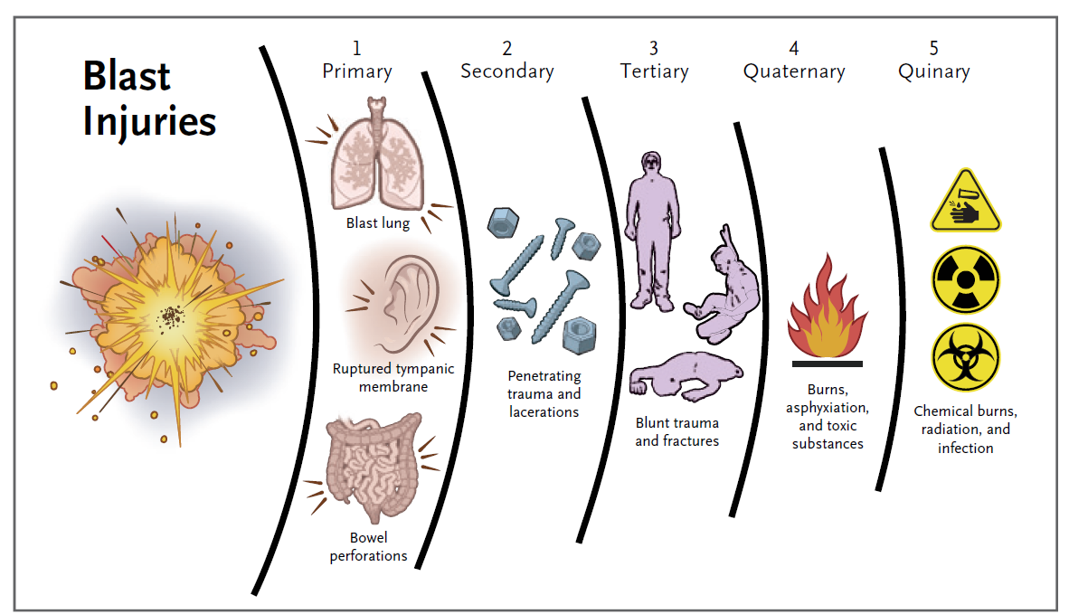
Blast injuries
Category | Cause | Possible Injuries
Primary | Blast shock wave | Blast lung, ruptured tympanic membrane, bowel perforations
Secondary | Flying fragments/ debris | Penetrating trauma and lacerations
Tertiary | Blast wave propels patient against objects | Blunt trauma and fractures
Quaternary | Other explosion related injury and illnesses | Burns, asphyxiation, toxic substances
Quinary | Resulting from additives such as bacteria and radiation | Chemical burns, radiation, infection
Notes:
Ref: Ambulance Care Essentials 2nd Edition Chapter 16, pg 254
On mouseclick, a diagram to represent the table contents will appear
Use the arrows or P/N to switch between the table and diagram to discuss

Slide 18
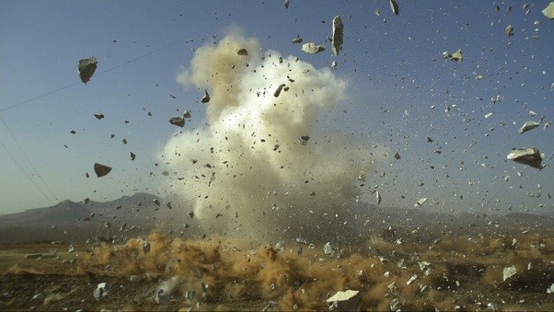
Blast Injuries
Suspension, Hanging, Blast and Ballistics – Component 8
Any Questions?

Slide 19
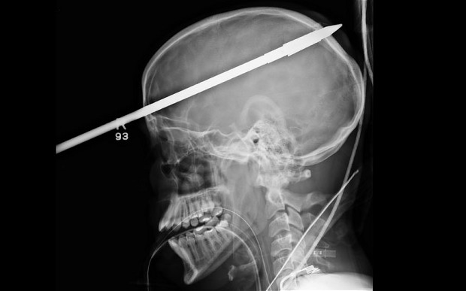
Penetrating Trauma
Suspension, Hanging, Blast and Ballistics – Component 8

Slide 20
Penetrating trauma
Suspension, Hanging, Blast and Ballistics – Component 8
Stab wounds
Gunshot wounds
Notes:
Ref: Ambulance Care Essentials 2nd Edition Chapter 16 pg 250

Slide 21
Stab Wounds
Suspension, Hanging, Blast and Ballistics – Component 8
Low velocity –
Stab wounds are low energy penetrating trauma
Multiple wounds from a single weapon
Notes:
Ref: Ambulance Care Essentials 2nd Edition chapter 16 pg 250

Slide 22
Stab wounds
Suspension, Hanging, Blast and Ballistics – Component 8
Knife, scissors and ice picks are common weapons
Injury is often limited to depth and area of penetration
May leave only small external injury with significant inside damage
Notes:
Ref: Ambulance Care Essentials 2nd Edition chapter 16 pg 250
For example a screwdriver stabbed through the chest could damage the heart, but only leave a very small external would visible.

Slide 23
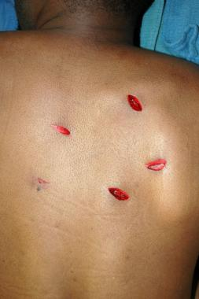
Stab wounds
Suspension, Hanging, Blast and Ballistics – Component 8

Slide 24
Gunshot wounds
Suspension, Hanging, Blast and Ballistics – Component 8
Higher velocity weapons deliver much more energy into the patient.
They leave a permanent cavity in the body and also create a temporary cavity when the projectile enters the body
Notes:
Ref: Ambulance Care Essentials chapter 16 pg 250

Slide 25
Gunshot wounds
Suspension, Hanging, Blast and Ballistics – Component 8
High velocity weapons –
High energy projectile enters the body
Creates much more potential for injury
Projectile pathway is often erratic
Notes:
Ref: Ambulance Care Essentials 2nd Edition chapter 16 pg 250

Slide 26
Gunshot wounds
Suspension, Hanging, Blast and Ballistics – Component 8
Cavitation-
Permanent cavity formed by the pathway of the projectile
Temporary cavitation is relative to the energy that comes with the projectile
The greater the energy - the greater the temporary cavity produced
Has the same effect as an explosion inside the body
Creates a large exit wound in comparison to entrance wound
Notes:
Ref: Ambulance Care Essentials 2nd Edition chapter 16 pg 250

Slide 27
Gunshot wounds
Suspension, Hanging, Blast and Ballistics – Component 8
Ricochet-
Bullet does not always follow a straight path
Increases tissue damage
Pathway becomes erratic
If no exit wound then all of the kinetic energy has been transferred to the body
Notes:
Ref: Ambulance Care Essentials 2nd Edition Chapter 16 pg 250

Slide 28
Gunshot wounds
Suspension, Hanging, Blast and Ballistics – Component 8
Entry and exit wounds-
Entrance wound is often the size of the projectile
Exit wound can be considerably larger and not always in an expected place
Notes:
Ref: Ambulance Care Essentials Chapter 16 pg 250

Slide 29
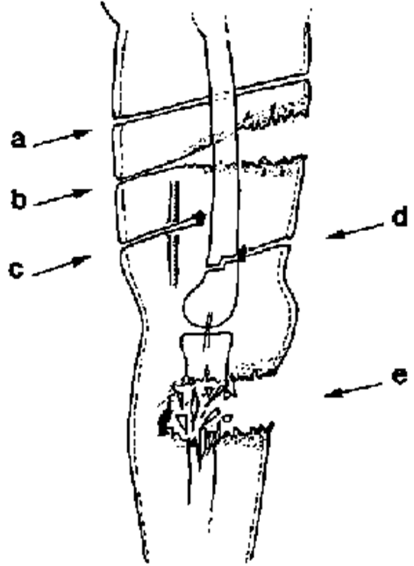
Suspension, Hanging, Blast and Ballistics – Component 8
Notes:
A – straight permanent cavity

Slide 30
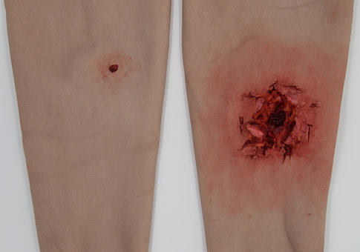
Gunshot wounds
Suspension, Hanging, Blast and Ballistics – Component 8

Slide 31
Things to Consider
Suspension, Hanging, Blast and Ballistics – Component 8
Scene safety
Weapon type
Anatomic structures along potential projectile path
Crime scene
Patient care is top priority
Kinetic energy

Slide 32
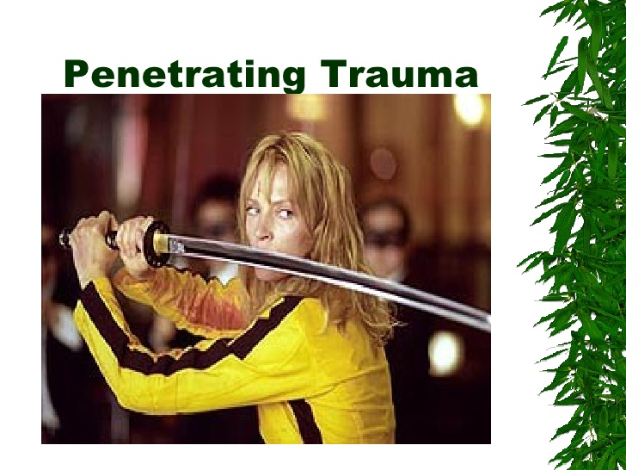
Any Questions?
Suspension, Hanging, Blast and Ballistics – Component 8

